Slide 1


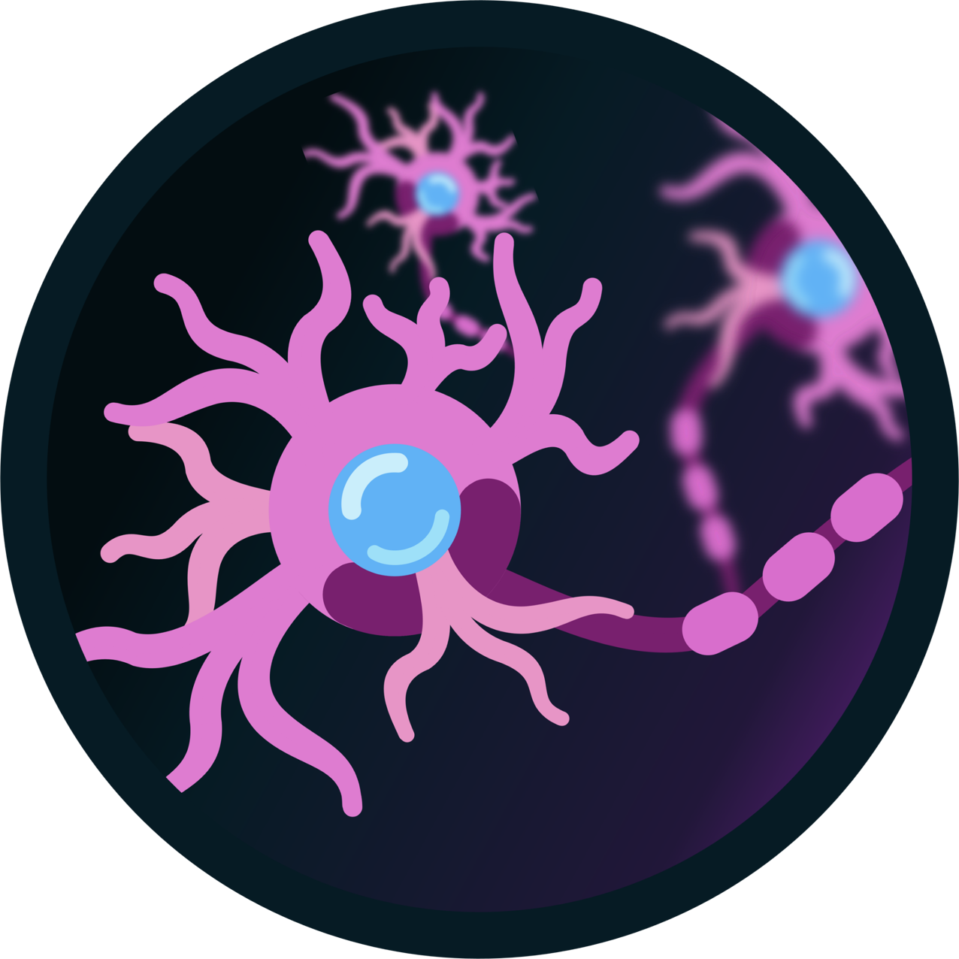

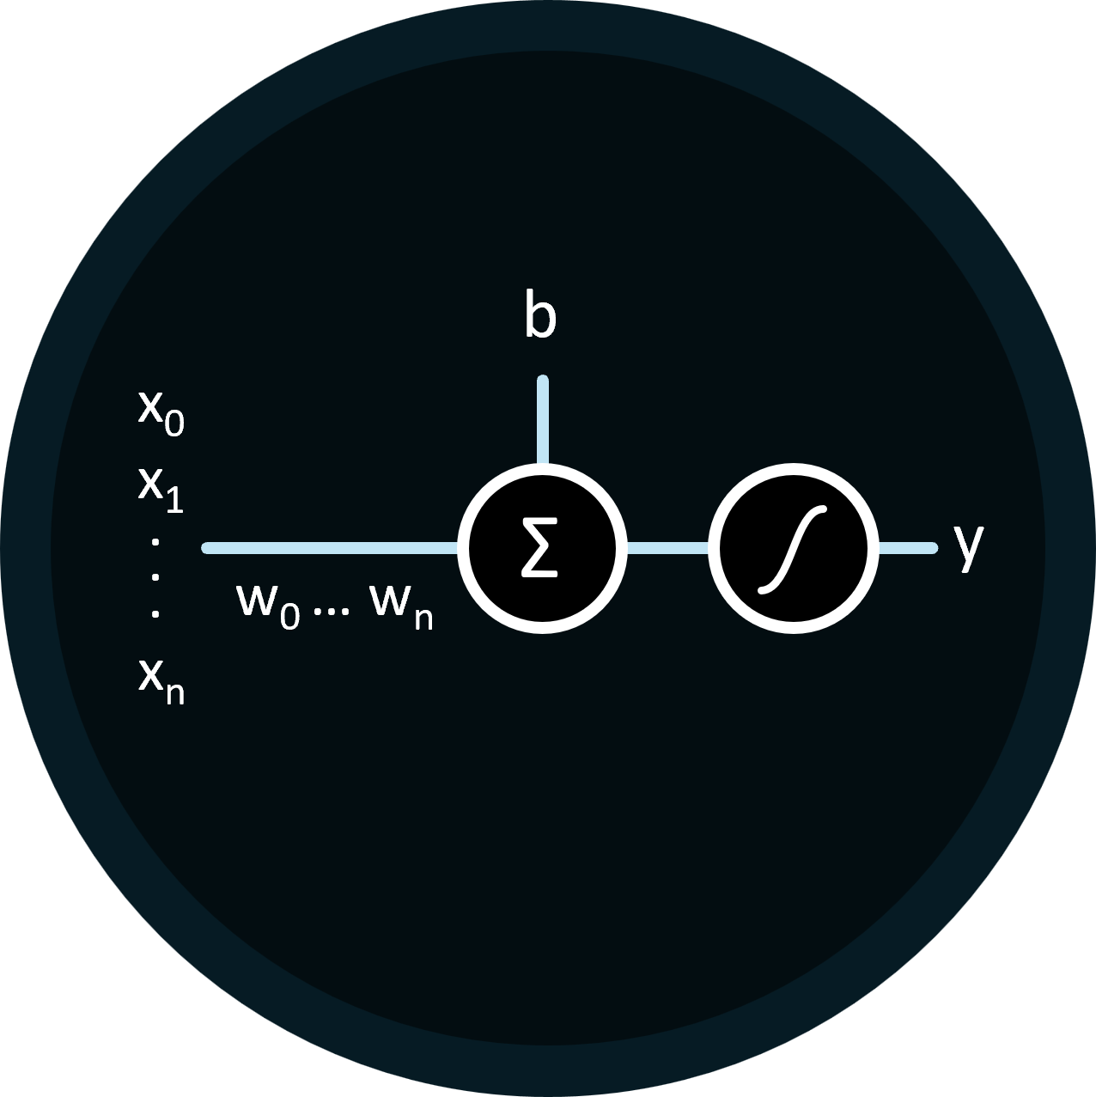




Perceptrons: The First Trainable Neural Networks
Christopher, Harvey, Sean, Nathan
Introduction -
From Biological to Artificial
Humble Beginnings -
The Single Layer Perceptron
Learning from Mistakes -
Backpropagation
Introducing Complexity -
The Multi-Layer Perceptron
The perceptron model is trained by tweaking the weights such that for a given input we get the expected output. The algorithm used to do so is called backpropagation.
For a given input, the model may produce some incorrect output.
…
Biological brains are made up of many individual neurons which share inhibitory and excitatory connections with each other. An inhibitory connection reduces a neuron's likelihood of activation, while an excitatory connection increases it. When a neuron is sufficiently excited, it will fire an activation signal which propagates through said connections. It should be noted that every neuron has its own activation threshold.
At the heart of bringing simulated biological neurons to life was the perceptron: a computerized model based on the brain that has the ability to learn.
In this model, the perceptron represents a single neuron. The inputs (x_{i}) to the perceptron can be seen as other neurons, represented by continuous values that indicate their level of excitement—the higher the value, the more excited the neuron; the lower the value, the less excited it is.
The inhibitory and excitatory connections to said inputs are represented by weights (w_{i}) which are also continuous values. A negative value represents an inhibitory connection whilst a positive value is an excitatory connection. These weight values are multiplied with their respective input providing a value that represents the contribution that input makes to the final activation state of the perceptron.
A constant bias (b) term is added to represent the activation threshold of the perceptron.
By summing up each input’s contribution with the bias, the final activation state of the perceptron can be found. This value is then passed through an activation function to introduce non-linearity, allowing the perceptron to learn more complex patterns.
The brain is comprised of billions of neurons, a far larger amount than a single perceptron. The Multi-Layer Perceptron model extends this by introducing hidden layers comprising of multiple perceptrons.
These hidden layers allow the model to learn non-linear decision boundaries whereas a Single-Layer Perceptron model can only learn linear decision boundaries (problems where data can be separated by a straight line).
If computers could artificially simulate biological neurons and the information represented by their connections, then maybe computers could learn to replicate human intelligence as well.
1943 McCulloch and Pitts: Artificial Neurons
1957 Frank Rosenblatt: The Perceptron Model
Endless Possibilities -
Deep Machine Learning

Slide 2
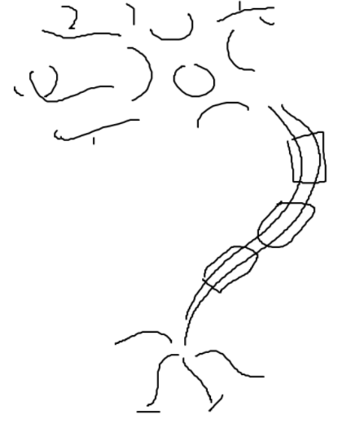
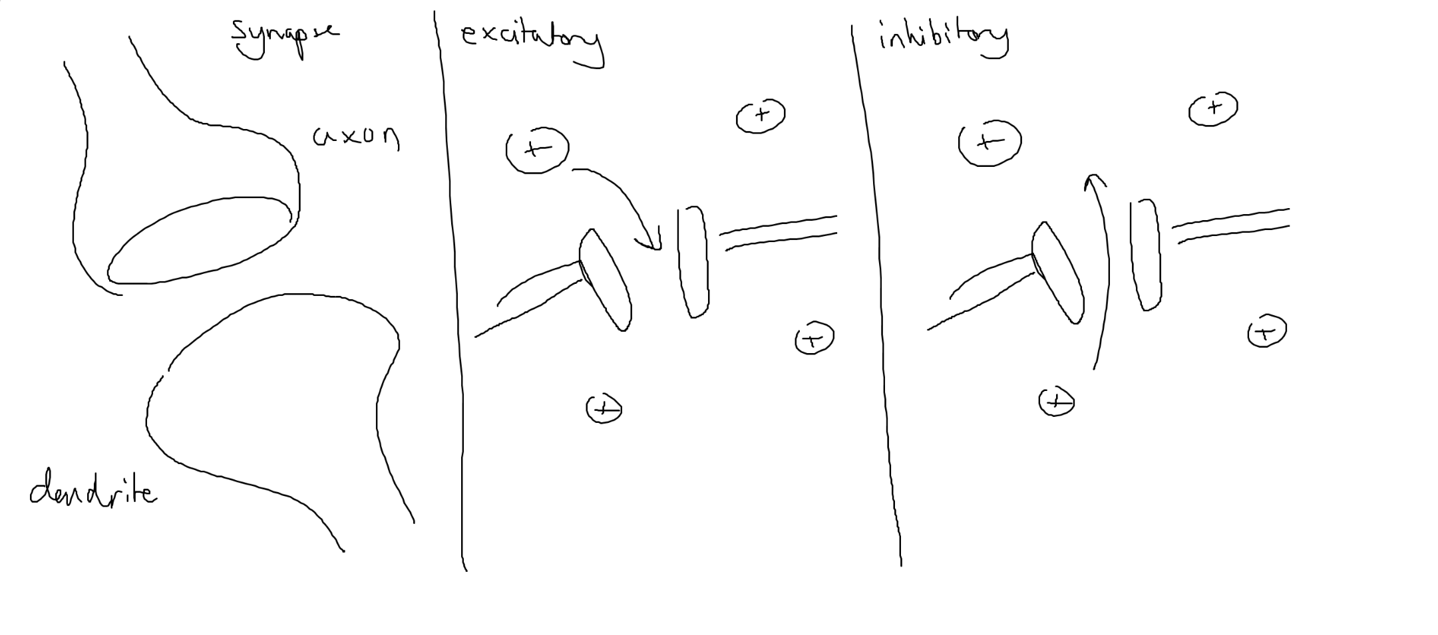
Perceptrons: The First Trainable Neural Networks
Christopher, Harvey, Sean, Nathan
1
Introduction -
From Biological to Artificial
Biological brains are made up of many individual neurons which share inhibitory and excitatory connections with each other. An inhibitory connection reduces a neuron's likelihood of activation, while an excitatory connection increases it. When a neuron is sufficiently excited, it will fire an activation signal which propagates through said connections. It should be noted that every neuron has its own activation threshold.
If computers could artificially simulate biological neurons and the information represented by their connections, then maybe computers could learn to replicate human intelligence as well.
1943 McCulloch and Pitts: Artificial Neurons

Slide 3



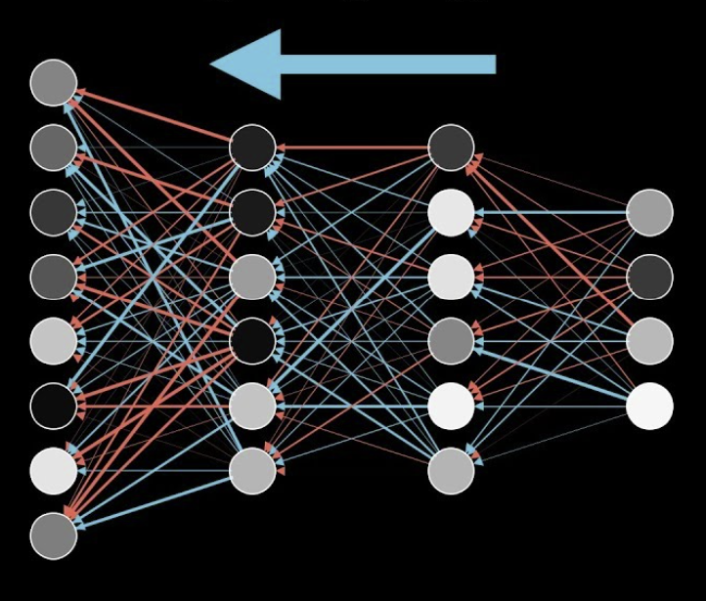

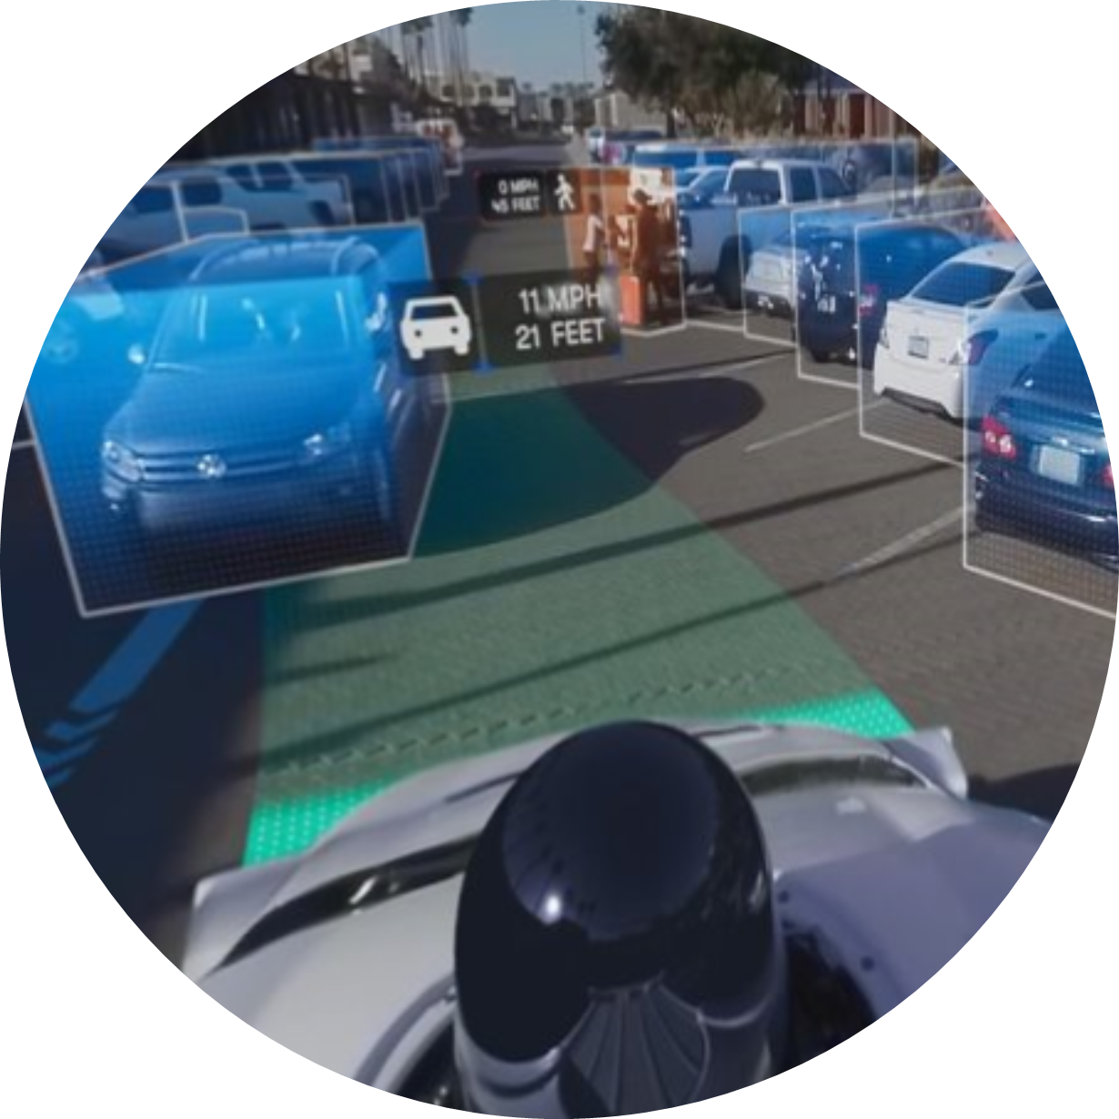

Green, Red Yellow
Perceptrons: The First Trainable Neural Networks
Christopher, Harvey, Sean, Nathan
Target Audience: Sixth Form Computer Science Students
Introduction –
From Biological to Artificial
– Humble Beginnings
The Single Layer Perceptron
Biological brains contain billions of individual neurons which can send signals between each other.
At the heart of bringing simulated biological neurons to life was the perceptron: a computerised model based on the brain that has the ability to learn.
1
When a neuron fires, the axons release neurotransmitter chemicals that are received by the dendrite.
1
The perceptron mimics a single biological neuron, receiving inputs (x_{i}) that represent other neuron’s excitement levels.
2
Upon receiving a signal, depending on the type of connection, gates in the cell wall, allowing the flow of ions. A positive change in charge is excitatory, while a negative change is inhibitory.
2
The strength of each input connection is represented by a weight (w_{i}), where positive values are excitatory, and negative values are inhibitory.
3
Each input is multiplied by its weight, and the results are summed to determine the perceptron’s activation state. A bias (b) is added, acting as an activation threshold.
3
Once enough charge has accumulated, the cell fires, sending an electrical current down the neuron which triggers its axons to release neurotransmitters.
4
The final activation value is passed through an activation function which is a mathematical rule that decides whether a neuron should “fire” or not.
If computers could artificially simulate biological neurons and the information represented by their connections, then maybe computers could learn to replicate human intelligence as well.
Typically, the activation function is non-linear to allow the neuron to represent more complex patterns.
1943 McCulloch and Pitts: Artificial Neurons
1957 Frank Rosenblatt: The Perceptron Model
v
Endless Possibilities –
Deep Machine Learning
– Learning from Mistakes
Gradient Descent & Backpropagation
The perceptron model learns by adjusting weights based on errors until it reaches an acceptable threshold — a process called backpropagation.
1
Compute the error by determining difference between the predicted output and the actual target value is measured.
2
Determine how much each weight should be adjusted to reduce the error and move the output closer to the target.
3
Repeat for all inputs, summing the differences to get the required change to reduce the error across the entire domain.
4
These steps are repeated over many iterations until the model’s error is minimized. Over time becoming more accurate!
This iterative process is known as Stochastic Gradient Descent.

Slide 4
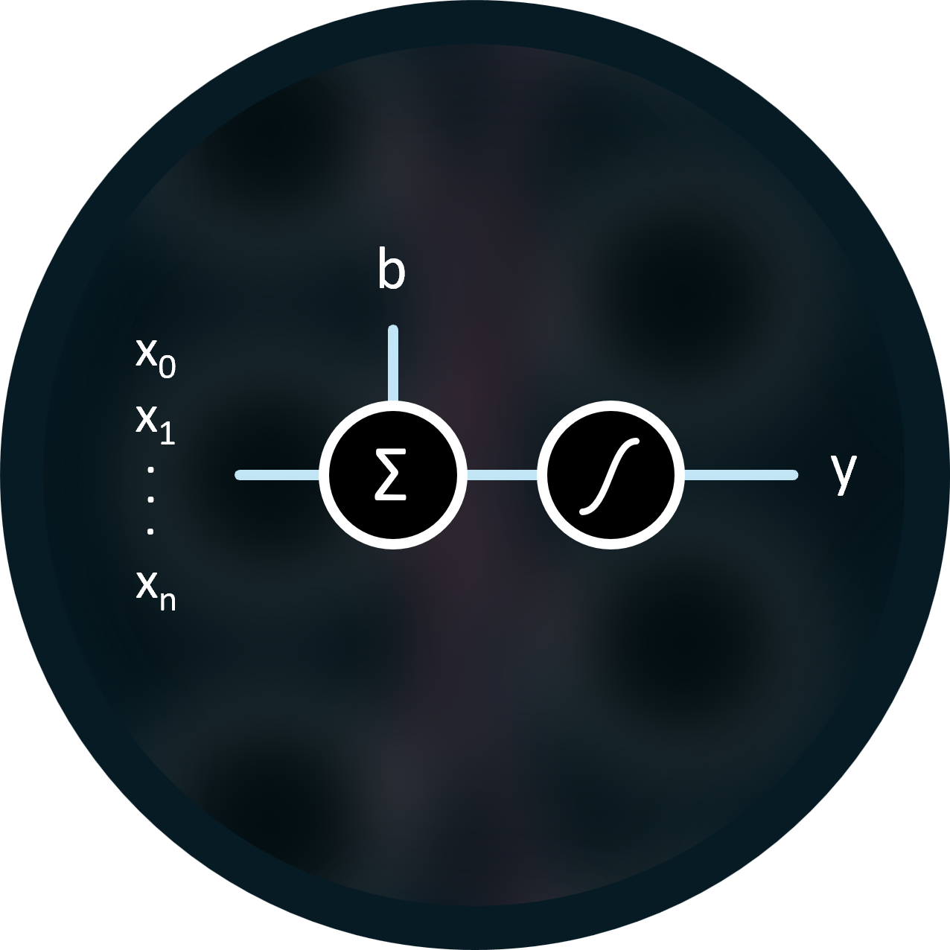




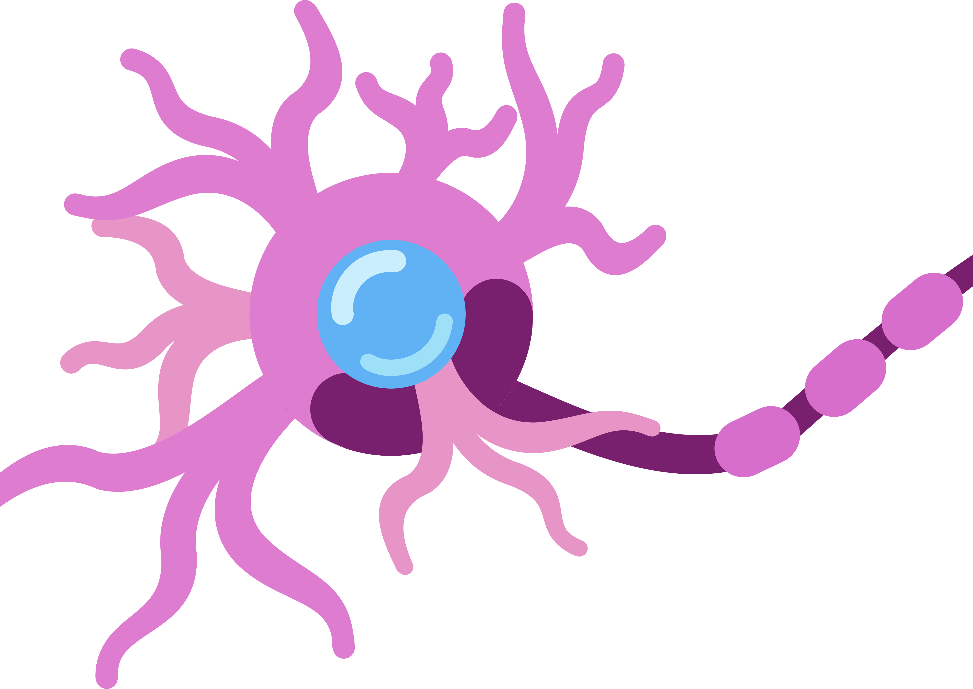
Biological brains contain billions of individual neurons which share inhibitory and excitatory connections with each other. An inhibitory connection reduces a neuron's likelihood of activation, while an excitatory connection increases it. When a neuron is sufficiently excited, it will fire an activation signal which propagates through said connections. It should be noted that every neuron has its own activation threshold.
x₀
b
x₁
.
Σ
y
.
.
x_{n}
x₀
b
x₁
.
Σ
y
.
w₀ … w_{n}
.
x_{n}

